Slide 1
Inclusive Payments Benefits Everyone
Financial Services for the Poor: Level One Project
James Dailey
June 18, 2015
Notes:
The Gates Foundation believes that everyone benefits from an economy that includes everyone. Yet today, billions of people—particularly in the world’s poorest countries—are excluded from a formal economy and miss out on the many advantages that these financial systems offer.
We need to change this. We have the power to change this. And it’s in everyone’s best interests if we do.
Thanks to the rapid rise of digital payment systems, as well as the ubiquity of mobile technology, we’re now in a position to create digital economies within countries that will help billions take a big step toward financial stability and advance the goals of all involved: bankers, mobile operators, payment technology companies, government regulators, and more.
To achieve this, we must build upon existing infrastructure and work within individual countries to establish zero barriers to entry within one digital financial system. It’s this attainable goal that is at the heart of The Level-One Project—our initiative to work across public, private, and nonprofit sectors to build inclusive, interconnected digital economies in every country around the world.
Now is the time to build on lessons learned, leverage our available resources, and create easy, secure digital financial systems that benefit everyone—both those most in need and those who are in a position to make a difference.
Zero barriers to entry within one digital financial system. That’s The Level-One Project.

Slide 2

THEORY OF CHANGE – FINANCIAL SERVICES FOR THE POOR
Outputs
Outcomes
Impact
Intervention areas
Expand the Digital Financial Infrastructure
Expand the digital financial infrastructure so that poor people can access digital money and use it to transact with their peers, businesses, and government
Accounts which can connect digitally to other accounts
Population within 5km of access point
Reduced transaction costs
Fewer people
fall into
poverty
Poor people manage their money digitally
By 2035, 80% of adults worldwide and 60% of <$2/day adults actively use a digital account to access at least one financial service beyond payments (credit, savings, insurance)
Drive Participation in the Digital Financial System
Create value that results in poor people joining the system because financial service providers design products to meet the needs of the poor and can offer them profitably
<$2/day adults use a digital account
Digital bulk payments
Number/type of financial products available digitally
Foster Regulations and Policy
Adapt regulations to enable poor people to open accounts, to allow providers to outsource distribution, and to protect users
Reforms adopted on e-money account issuing, KYC requirements, and distribution
More people
move out of
poverty faster
More people move out of poverty faster
Notes:
Poor people do not live in a static state of poverty. Every year, many millions of people transition out of poverty by successfully adopting new farming technologies, investing in new business opportunities, or finding new jobs. At the same time, large numbers of people fall back into poverty due to health problems, financial setbacks, and other shocks. However, it is costly to serve poor people with financial services, in part because most of their transactions are conducted in cash.
Big trends
Mobile phones
&
Emerging digital payment technologies
that have the potential
to strip 90 percent of the costs out
of transactions

Slide 3
What if? FSP Innovation Landscape
What If
1
Customer Activation
2
3
4
Distribution
Payments Front-End
Payments Back-End
What If:
We could turn a 30 day sign up process into 30 seconds?
What If:
Everyone was
an agent?
What If:
Anyone with a phone could send or receive money?
What If:
Payment processing was digital and close to zero in cost?
5
6
7
8
Integration
Products
Analytics
Enabling Regulatory Environment
What If:
You could send money to any person in the world?
What If:
Every mobile phone came
with a savings account and insurance?
What If:
Assessing risk for
a billion new customers was cost-effective?
What If:
A pro-poor regulatory environment facilitated financial inclusion?
CONFIDENTIAL: FSP Strategy Review—Co-chair Presentation
Notes:
Being able to try something quickly out is a key determinant for consumer uptake. If it is as difficult to open an account with a mobile money operator as it is to open a bank account, then we will have the same result.
Current models assume that you have lots of cash in and cash out and therefore expensive chokepoints in the arrangement – this is highly inefficient. What if everyone had the ability to take physical money and turn it into digital cash.
Mobile first
Back end processing should not cost 1000s of times more than sending an email
anyone anywhere
Products that people need and should have the right to access (why do we tolerate a system where we have easy access to such services but the poor do not?)
With better design analytics becomes trivial
Regulatory changes may be needed

Slide 4
Lower Income Consumers
Lower Income Consumers
DFS System Reference Model
Agents
Digital Financial
Services Providers
National Digital Financial
Services System
Digital Financial
Services Providers
Agents
Account Opening
Service
Interoperability Service
for Transfers
Account Opening
Service
Consumer Account
Management
Fraud and Risk
Management Service
Consumer Account
Management
Small Payees
(Merchants
Schools
Clinics)
Small Payees
(Merchants
Schools
Clinics)
Agent and Merchant
Account Management
Higher Income
Consumers
Higher Income
Consumers
Large Payees
(Merchants
Utilities Hospitals)
Card Networks
Large Payees
(Merchants
Utilities Hospitals)
ACH
RTGS
Retail and
Commercial Banks
Retail, Commercial, and Settlement Banks
Large Payers
(Governments
Employers
NGOs)
Large Payers
(Governments
Employers
NGOs)
Central Bank

Slide 5
Roadmap
Apps
Innovative Applications, Products & Services
Enable market ecosystem innovation that delivers affordable, effective pro-poor
services and products across sectors such as health, education, agriculture, retail, small & medium enterprises.
Accounts
Digital Accounts & Transactions
Enable easy and efficient account opening, account access and effective digital financial services for consumers, agents, merchants and providers of payments and payment processing services.
Rails
Infrastructure for Connectivity, Interoperability, Clearing, Settlement
Design, deploy and operate a robust digital financial services infrastructure that enables real-time transactions, efficient end to end interoperability across many market participants while ensuring adequate fraud and risk management controls are in place to protect individuals and participants.
Rules
Regulatory and Governance Framework
Establish Legal and Regulatory Framework to initiate and sustain digital financial services scheme and platform ensuring safety, security, efficiency and innovation while reaching the lowest income citizens with extremely low cost services.

Slide 6

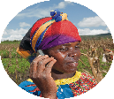

DFS Roadmap
Use Cases
Screen Setup
Telenaira
NigeriaCom
Make Bulk
Payments
to Anyone
Self-Issue
Send Money
to Anyone
Buy Things
from Any
Merchant
Keep Money
Secure.
Check Balance.
World Food Program
User’s Phone
IST
Settlement
Bank
NGO/GO Portal
Make bulk payment
USSD Emulator of
Bolajy’s Phone
Bolajy opens account with national ID, sets PIN
Observe alt ID
Observe account limits
USSD Emulator of
Bolajy’s Phone
P2P to Dupe for 135 using phone number
Observe fee transparency
USSD Emulator of Patience’s Phone or Smart Phone
Patience (Merchant) requests payment from Bolajy for 75 using alt id
USSD Emulator of
Bolajy’s Phone
Run mini statement to see balance and a summary of all transactions, including fees
NGO/GO Portal:
Generate Report
Observe Pending status for Bolajy
Observe successful payments status
Review detailed errors
SMS: Bolajy’s Phone
Receive SMS indicating a payment has been received, amount and payer
SMS: Dupe’s Phone
Receive SMS to confirm payment amount and payer
USSD Emulator of
Bolajy’s Phone
Check pending transactions and approves transaction with PIN
Observe fee transparency
Bolajy
Eze
Individual
MFSP
Telenaira
Phone Number
206.474.4650
DOB
16/04/1976
National ID
54321
Alt ID
000-103-300
Dupe
Eze
Individual
MFSP
Nigeriacom
Phone Number
253.332.8912
DOB
16/04/1977
National ID
N/A
Alt ID
0000-303-289
Patience
Chukwu
Merchant
MFSP
Nigeriacom
Phone Number
253-332-9474
DOB
08/02/1975
National ID
N/A
Alt ID
0000-303-272
SMS: Bolajy’s phone
Receive SMS saying he has a pending payment and needs to open an account using the attached short code
SMS: Patience’s Phone
Patience gets SMS to confirm payment

Slide 7
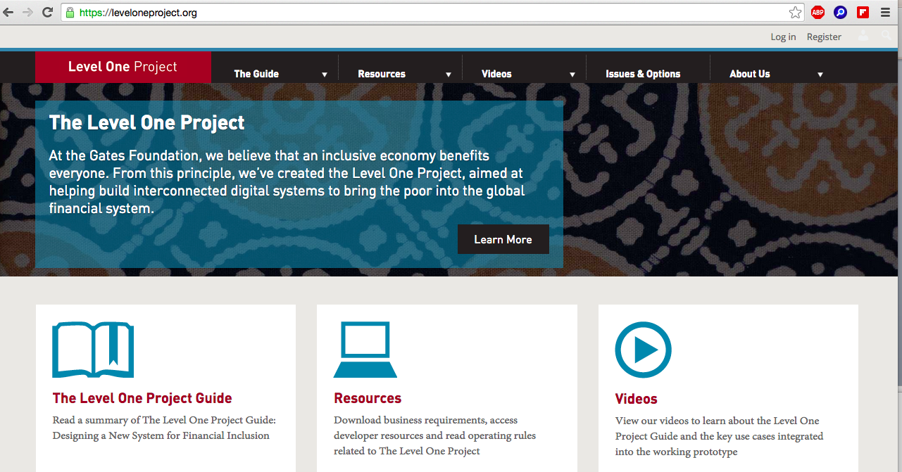
Level One Project (www.leveloneproject.org)
Design Principles for the Digital Payments System
Open loop
Immediate Funds Transfer
Same day Settlement
Push Payments
Open, international standards
Irrevocability
Shared fraud service
Tiered KYC

