Slide 1

How and Why to Use CC Legal Tools for PSI
Timothy Vollmer & Sarah Hinchliff Pearson
December 20, 2011

Slide 2
Wide government adoption
http://wiki.creativecommons.org/Government
1. Australia
2. New Zealand
3. Italy
4. Netherlands
5. United States

Slide 3
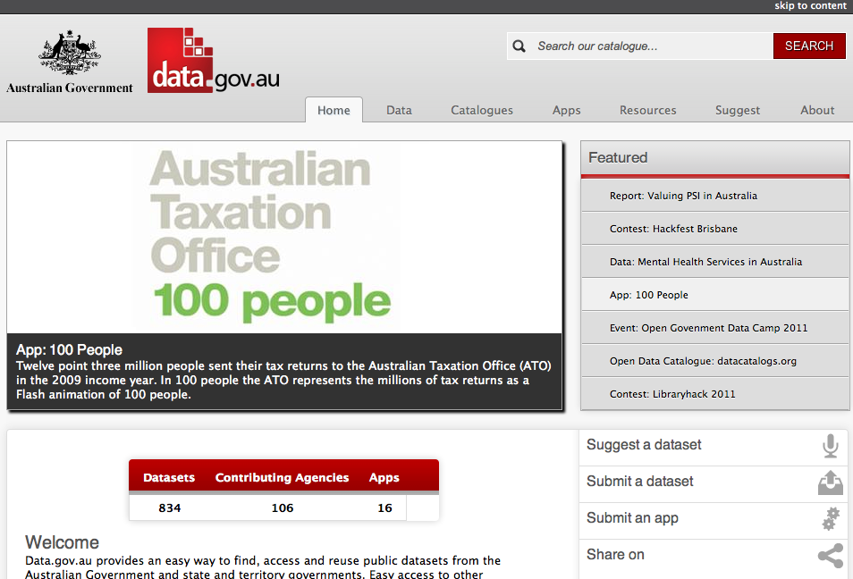

Slide 4
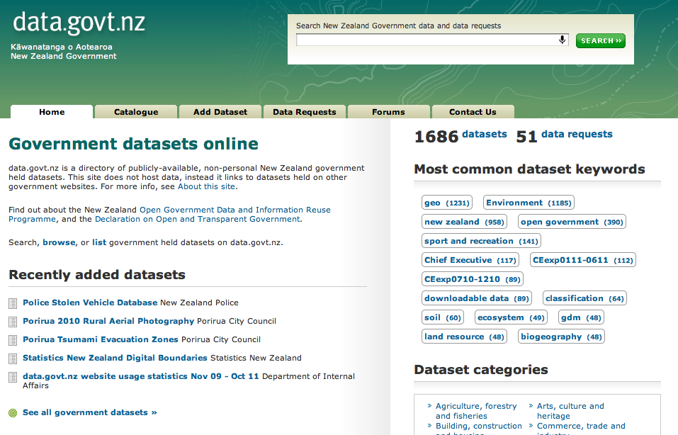

Slide 5
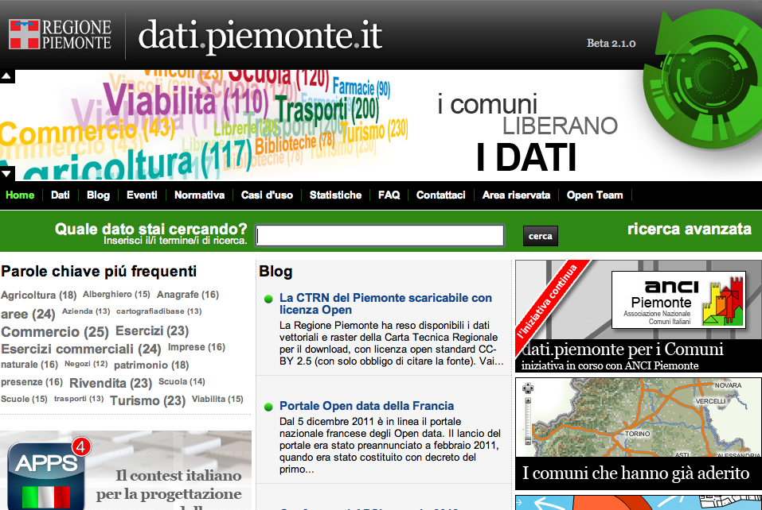

Slide 6
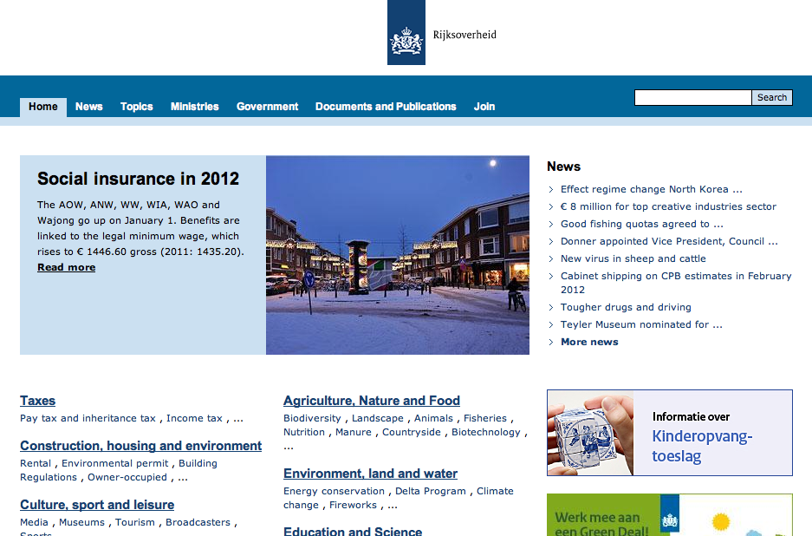

Slide 7
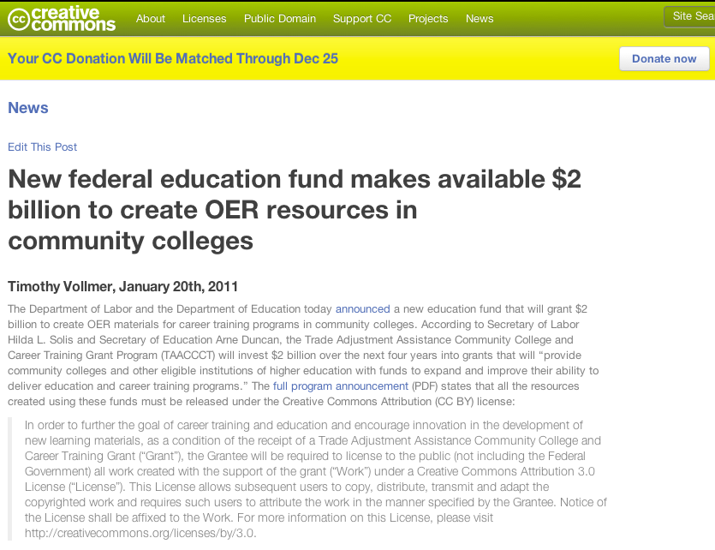

Slide 8
Other related CC adopters
GLAM Sector
  Europeana
Intergovernmental Orgs
  Commonwealth of Learning

Slide 9
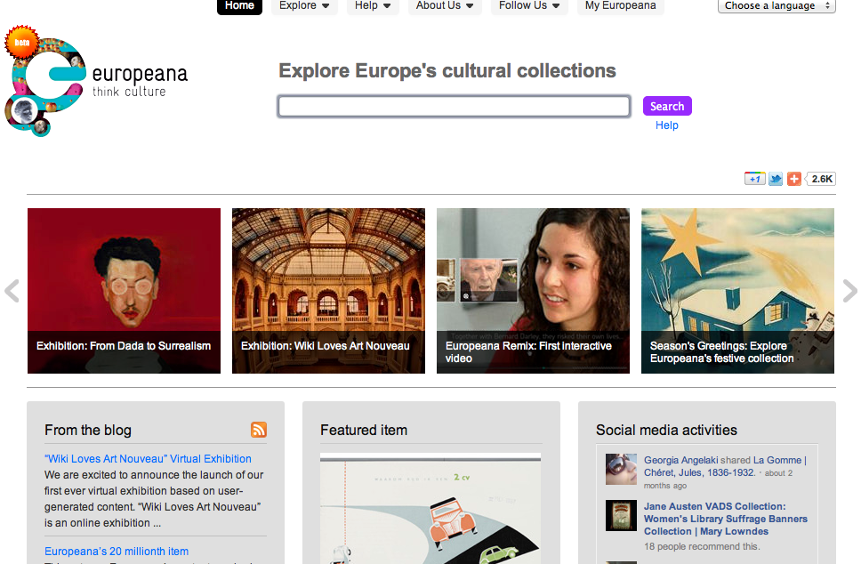

Slide 10
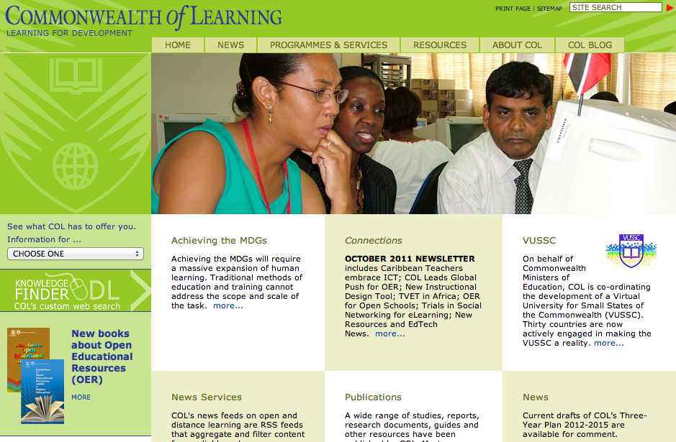

Slide 11
Why open licensing?
legal certainty
interoperability
notice
metadata

Slide 12
Why Creative Commons?
ensures credit
no endorsement
no misrepresentation
insignias & brands unaffected

Slide 13
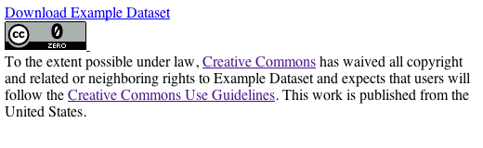
“CC Zero” http://creativecommons.org/publicdomain/zero/1.0/ http://wiki.creativecommons.org/CC0_use_for_data

Slide 14
Other options
Open Data Commons
UK Open Government License
custom licenses

Slide 15
CC version 4.0
database rights
internationalization
interoperability
simplifying attribution

Slide 16
Tim Vollmer & Sarah Hinchliff Pearson
12.20.11 slideshow licensed CC BY 3.0, except slides 3, 4, 5, 9, 10, and 13 used pursuant to the fair use doctrine and not subject to the license
Resources:
Slide 3 – Data.gov.au website, available at http://data.gov.au/
Slide 4 – Data.govt.nz website, available at http://data.govt.nz/
Slide 5 – Dati.piemonte.it website, available at http://dati.piemonte.it/
Slide 7 – CC website, specific post athttp://creativecommons.org/weblog/entry/26100
Slide 9 – Europeana website, available at http://www.europeana.eu/
Slide 10 – Commonwealth of Learning website, available at http://www.col.org/
Slide 13 – CC Labs website, specific post at
http://labs.creativecommons.org/2011/ccrel-guide/examples/dataset_cc0.html

